Slide 1


Team 30: ECEN 215 Lab Kit
Bi-Weekly Update 2 Members: Luis Diaz-Santini, Yusuf Hossain,
Ryan Freed, and Peter Zhang Sponsor: Dr. Lusher
TA: Garret Brown
Notes:
Intro should take 30 seconds

Slide 2
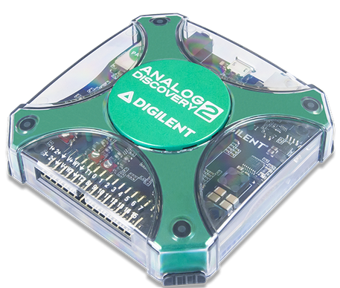
Project Summary
Problem Statement:
Principles of Electrical Engineering (ECEN 215) teaches the basics of electric circuit analysis and electronics to non-ECEN majors.
The transition of ECEN 215 to an online format poses a challenge due to its lab component relying on the Analog Discovery 2 (AD2), which is expensive.
Solution Proposal:
The ECEN 215 Lab Kit offers a solution to the cost, convenience, and over complication issues that are abundant with the AD2. Aiming for a $50 price point, the lab kit offers a more catered simpler approach to each lab while also making it possible to complete at home.
Will operate as the power supply, signal generator, multimeter, and Oscilloscope.

Slide 3
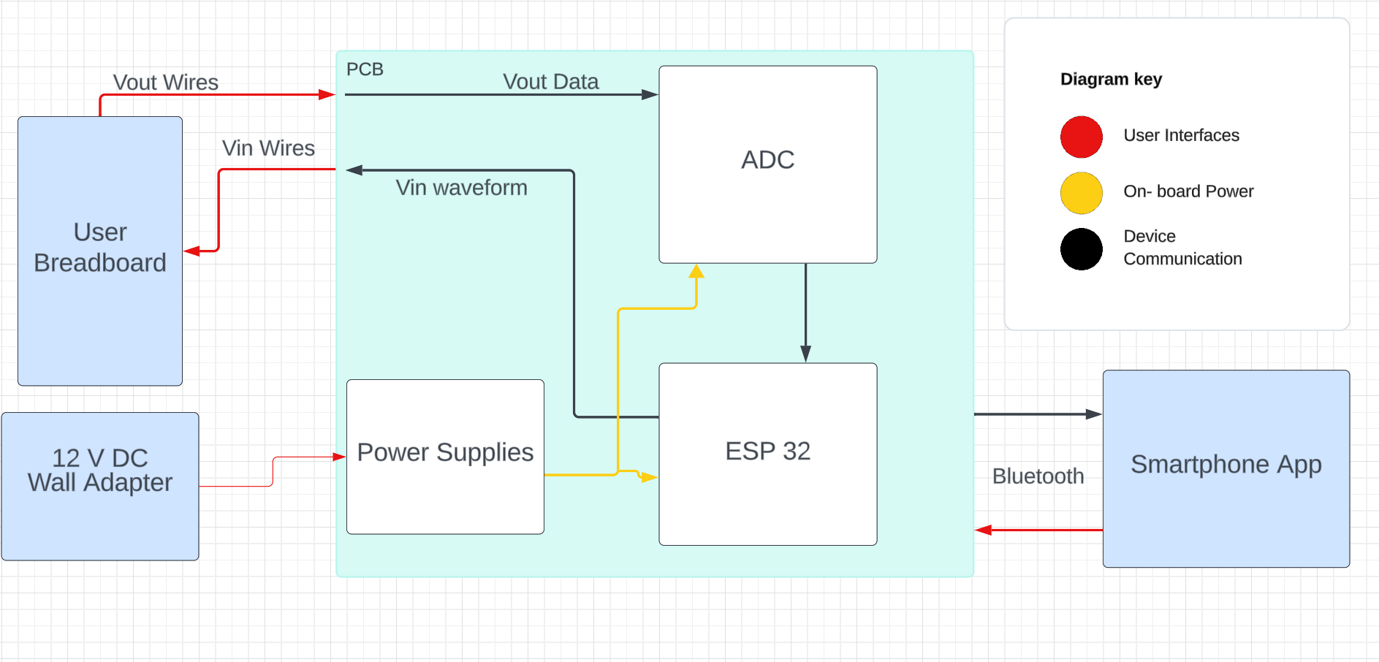
Subsystems Overview
Peter: Multimeter and Oscilloscope
Yusuf: Waveforms and communicating to the microcontroller.
Luis: Mobile application to interface with device
Ryan: PCB design and power.

Slide 4
Project Timeline
Ensure Working Subsystem (completed 8/22) | Research Integrating / Ensure Working Subsystems (completed 8/29) | Integrate App with Wave Gen and Oscilloscope (to complete by 9/24) | Integrate App with Multimeter (to complete by 10/16) | Complete Testing of Integrated Subsystems (to complete by 10/30) | Complete Validation of Integrated Subsystem (to complete by 11/7 | Documentation and Buffer Time (to complete by 11/10)

Slide 5
Waveform Generator
Yusuf Hossain
Accomplishments since last update 13 hrs of effort | Ongoing progress/problems and plans until the next presentation
Compacted all waveform shapes into 1 file without overloading ESP32 memory App is able to select between different waveform shapes | Resolve memory issues on the ESP32 with Wavegen function Work on displaying real time data for each waveform

Slide 6
Mobile App
Luis Diaz-Santini
Accomplishments since last update 17 hrs of effort | Ongoing progress/problems and plans until the next presentation
ESP32 successfully stores specific messages sent from application ESP32 can use the received messages to trigger actions | Solve memory issue with ESP32 Continue implementation of live oscilloscope graph displaying on application Determine which GPIOs to activate for power supply operation

Slide 7
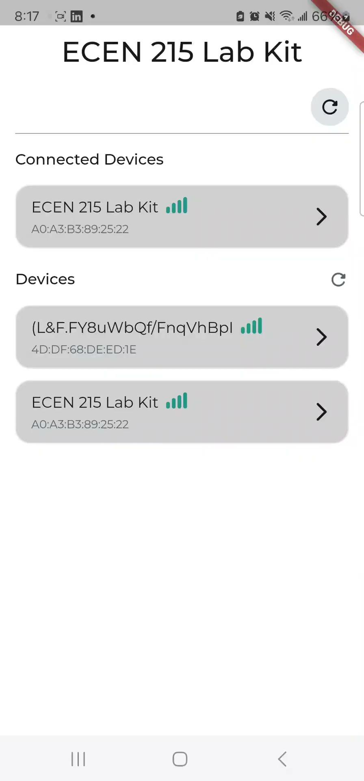
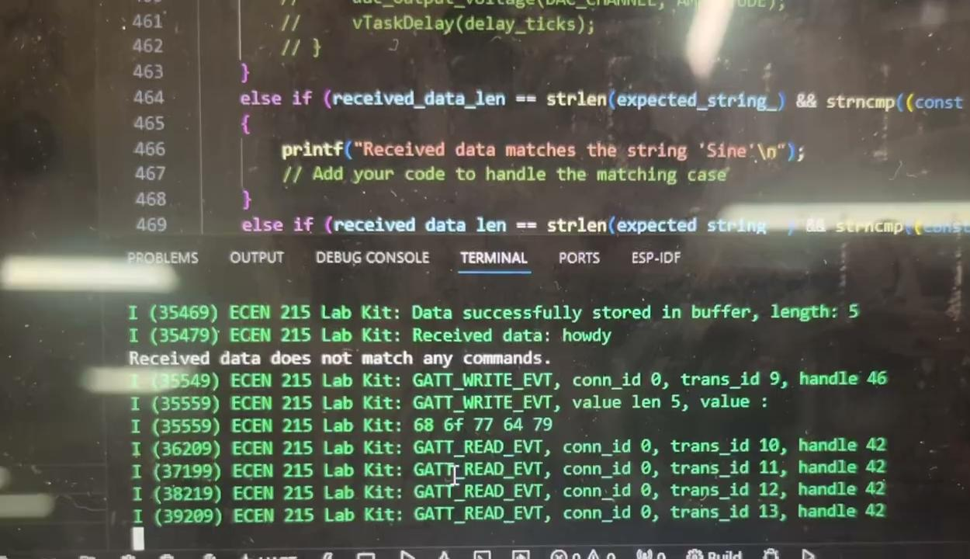

Slide 8
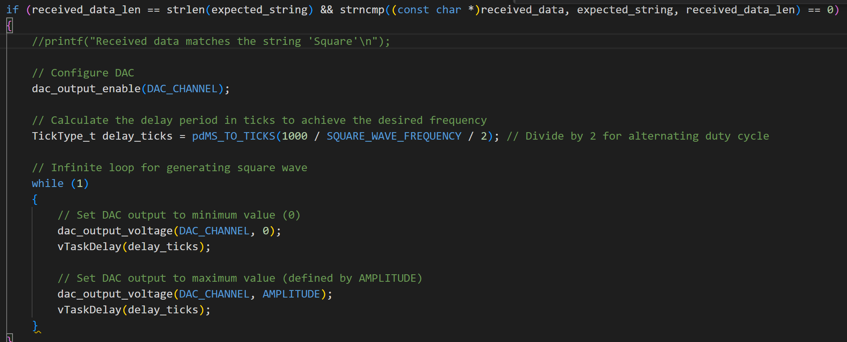
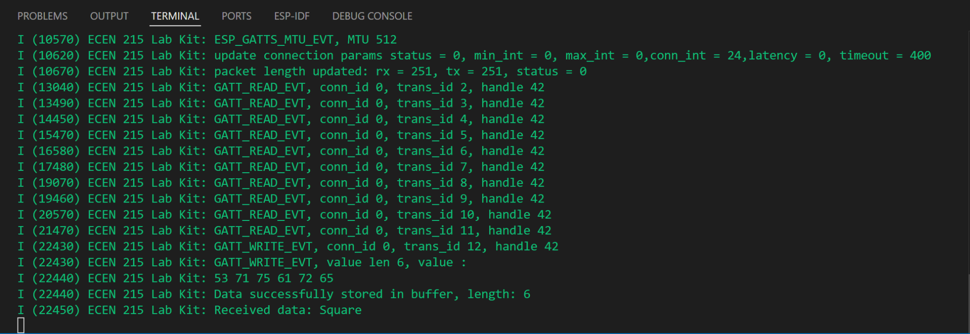

Slide 9
Oscilloscope and Multimeter
Peter Zhang
Accomplishments since last update 12 hrs of effort | Ongoing progress/problems and plans until the next presentation
Updated design of ohmmeter and ammeter Redesigned bipolar voltage capabilities ESP32 sends messages which are stored in app | Implementation of real time plotting oscilloscope on application Combined code crashing

Slide 10
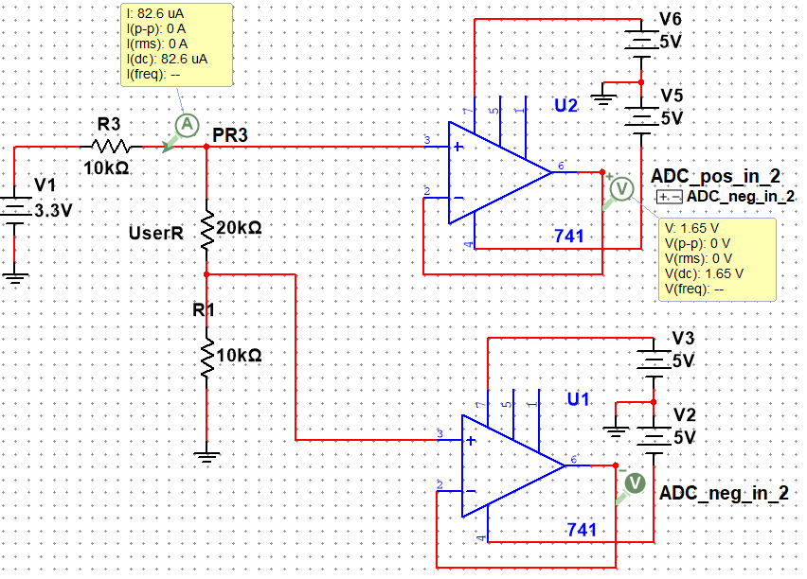
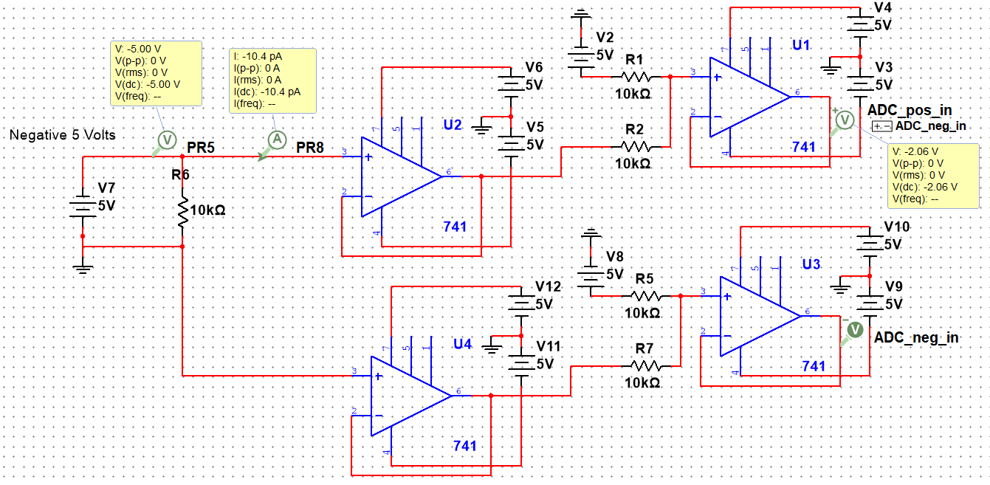
Updated Designs

Slide 11
PCB and Power
Ryan Freed
Accomplishments since last update 34 hrs of effort | Ongoing progress/problems and plans until the next presentation
Received and assembled 80% of PCB Pushed multimeter changes onto Altium schematics | Touch up soldering paste issues Troubleshoot buck converters Push multimeter changes onto PCB

Slide 12
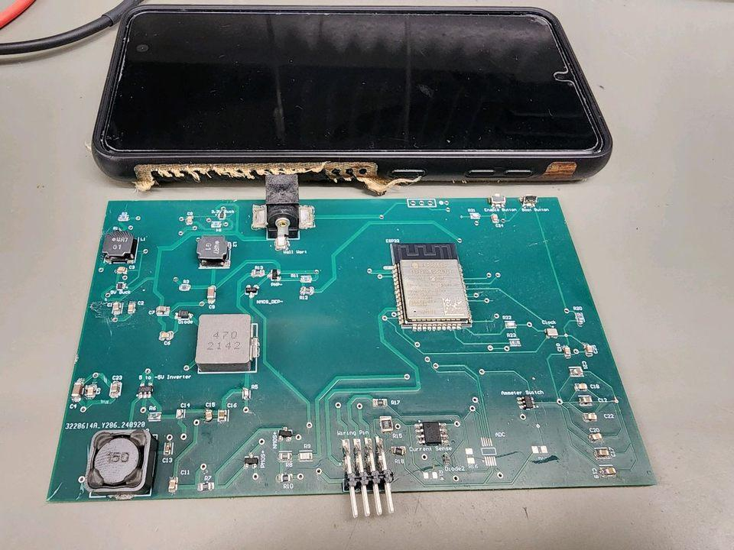

Slide 13
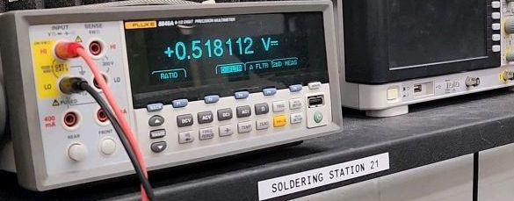
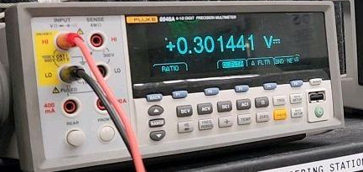
3.3 V test (top) and 5 V (bottom)

Slide 14
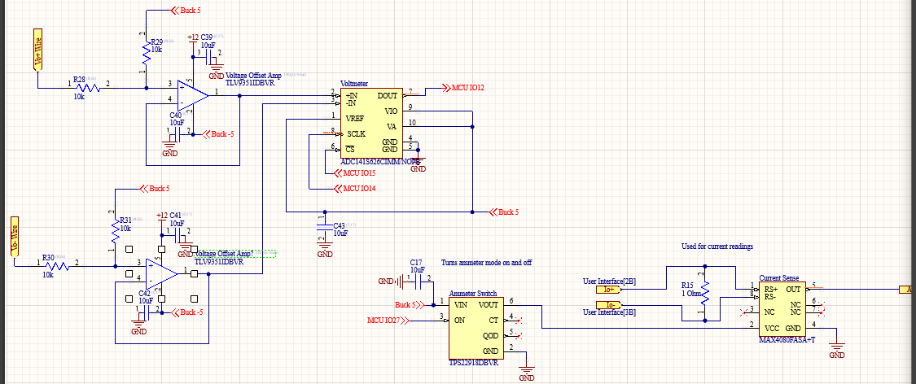
Voltmeter (left) and Ammeter Switch (right)

Slide 15
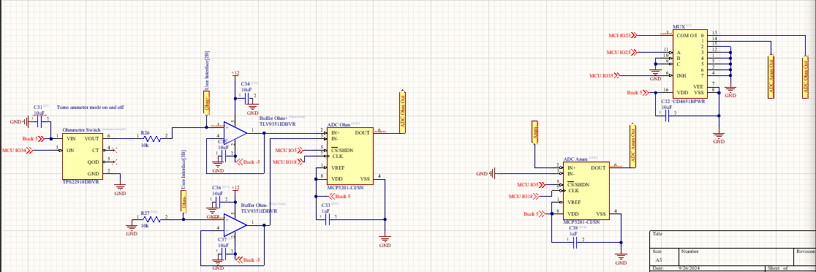
Ohmmeter (left) and Ammeter (right)

Slide 16
Parts Ordering Status
Ordering ADC by tomorrow
Ordering amplifiers
Ordering resistors and other small components
Notes:
Michelle

Slide 17
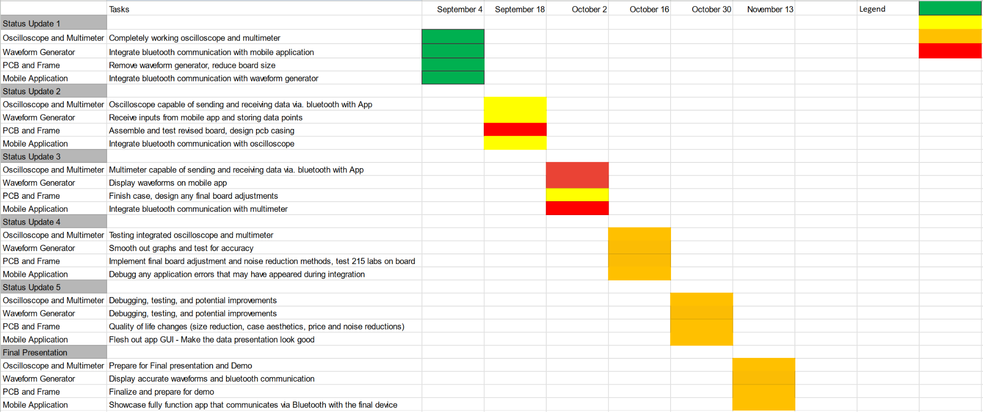
Execution Plan
Notes:
Michelle

Slide 18
Thank you

